Slide 1
Agentic AI
Atul Kahate
atulkahatecdac@gmail.com
https://www.linkedin.com/in/atulkahate/

Slide 2
Introduction to Agentic AI

Slide 3
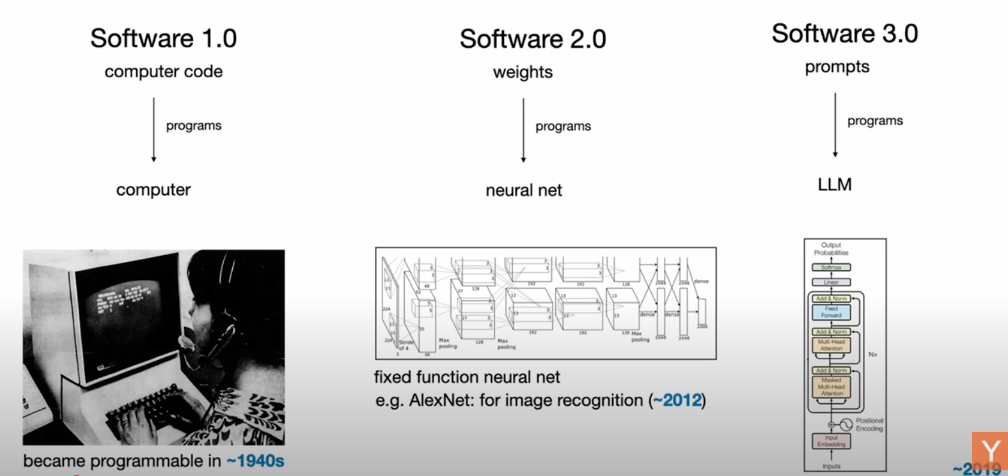
Andrej Karpathy
https://www.youtube.com/watch?v=LCEmiRjPEtQ&t=1693s

Slide 4

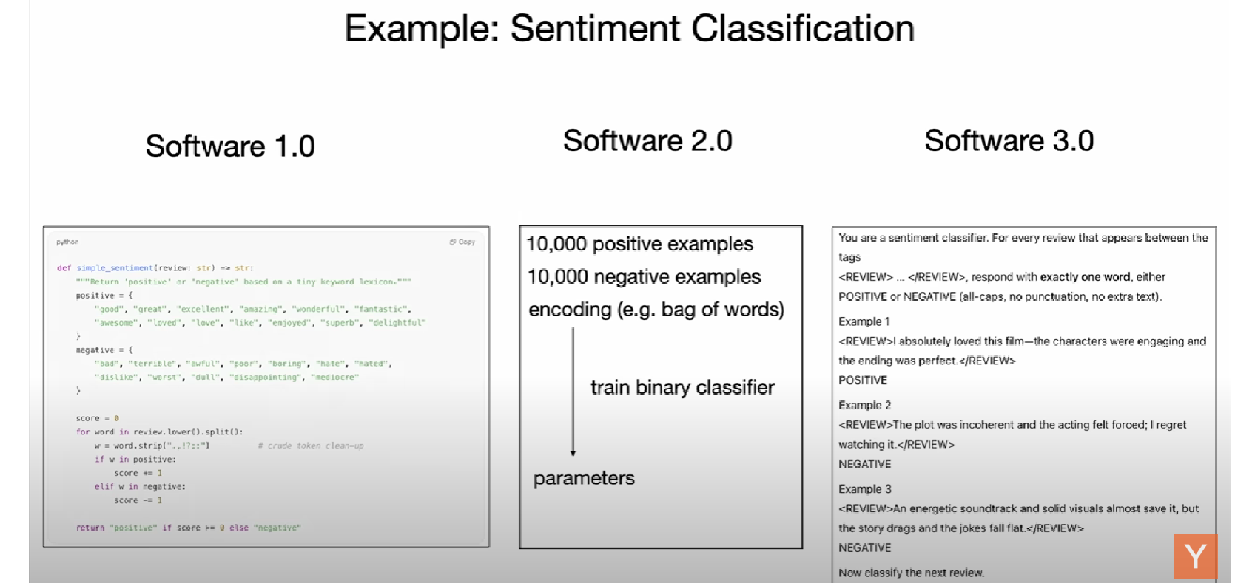
Andrej Karpathy
https://www.youtube.com/watch?v=LCEmiRjPEtQ&t=1693s

Slide 5
Large Language Model (LLM)
Aspect | Details
Definition | A type of AI model trained on vast amounts of text data to understand, generate, and reason using human-like natural language
Popular Examples | • GPT-5 (OpenAI) • LLaMA (Meta) • Claude (Anthropic) • Gemini (Google DeepMind) • Mistral (Mistral AI)
Key Capabilities | Answer questions and explain concepts, Generate text — essays, articles, stories, or code , Translate between languages, Summarize large documents, Engage in natural, context-aware conversation
Applications | Virtual assistants and chatbots, Content creation and copywriting, Code generation and debugging, Education and tutoring, Research assistance and data analysis

Slide 6



LLM and Tools
An LLM just predicts the next token (word) and it may not have up to date information
But then how can it answer a question such as What are the business headlines of today?
Reason: They run inside an application and have access to tools
AI Application (e.g. ChatGPT)
You are a helpful assistant
You can use the following tools: WEB SEARCH, CALCULATOR, …
LLM
(e.g. GPT-4o)

Slide 7
AI Agent
AI Agent: A system that can perceive its environment, make decisions, and take actions in order to achieve specific goals
Like a software (or robot) that can sense, think, and act—sometimes even learning from experience
Key elements
Capability | Definition | Examples
Perception | Takes input from the environment | Camera images, text, audio, sensor data, user queries
Reasoning / Decision-making | Decides what to do using rules, logic, or machine learning | Choosing the best move in chess, planning a route, selecting a response
Action | Performs tasks based on decisions | Moving a robot arm, answering a question, executing a command
Learning (optional) | Improves performance over time using feedback | Updating chatbot responses, refining recommendations, improving accuracy

Slide 8
LLM Versus AI Agent
Aspect | LLM (Large Language Model) | AI Agent
Definition | A powerful language model trained on massive text data to understand and generate natural language | A system that uses an LLM (or other AI models) to perceive, reason, decide, and act in an environment to achieve goals
Core Function | Processes and generates text — answers questions, writes content, summarizes, translates, etc | Uses tools, APIs, or external data sources to perform real-world tasks (e.g., send emails, fetch live data, run code)
Example Models | GPT-5, Claude, LLaMA, Gemini, Mistral | AI Agent-building Platforms
Autonomy | Reactive — responds to prompts but doesn’t take initiative | Proactive — can plan, reason, and take multiple steps autonomously
Tool Use | Usually limited to language-only responses | Can call tools, APIs, or databases (e.g., Python, web search, SQL)
Memory | Short-term (per conversation) | Can maintain long-term memory or state across interactions
Analogy | Like a brain that understands and speaks | Like a worker that uses the brain (LLM) to complete tasks

Slide 9


Agentic AI
Traditional AI
Agentic AI
Reactive
Proactive
AI Wave | Description | Key Characteristics | Examples / Capabilities
First AI Wave | Machines were learning from humans — models trained on data to predict, classify, and respond | • Reactive • Dependent on user input • No autonomy | Machine learning models, chatbots, recommendation systems
Next AI Wave (Agentic AI) | Machines are now acting for humans — they understand goals and take steps proactively | • Proactive and goal-driven • Can plan, decide, and execute • Works autonomously across tools | • Calls APIs • Pulls and analyzes data • Sends emails or messages • Writes and tests code • Reviews its own results

Slide 10

Agent System Core Components
Component | Details
Model selection | At the heart of every agent-based system: Large or Small, Modality, Openness and Customizability, Cost and Latency
Tools | Local tools: Internal logic and computation without external dependencies API-based tools: External services or data sources Model Context Protocol (MCP): Standard mechanism to work with external tools
Memory | Short-term memory: Information relevant to the current task or conversation (e.g. previous queries of the user in the current session) Long-term memory: Store knowledge and experiences over extended periods of time
Knowledgebase | • Static knowledge (e.g., domain rules, ontologies, reference data) • Dynamic knowledge (e.g., updated facts, user-specific data, contextual insights) • Retrieval mechanisms (e.g., vector databases, embeddings, semantic search)
Orchestration | Turns isolated capabilities into end-to-end solutions (Compose, Schedule, Supervise a series of skills)
Orchestration
Model
Tools
Memory
Knowledgebase

Slide 11
Agentic Systems
Aspect | Workflows | Agents
Definition | Systems where LLMs and tools are orchestrated through predefined code paths. | Systems where LLMs dynamically direct their own processes and tool usage.
Control | Human developers define the flow and order of operations. | The LLM decides how to proceed, maintaining control over the process.
Flexibility | Fixed and predictable; follows preset logic. | Adaptive and dynamic; can change based on context.
Transparency | Easy to trace since logic is explicitly coded. | Harder to trace, since decisions emerge dynamically.
Error Handling | Anticipated and handled by predefined rules. | Must be handled by the agent itself during execution.
Use Cases | Standardized pipelines, routine automation, ETL tasks. | Open-ended reasoning, multi-step problem solving, research assistants.
Example | A data pipeline that extracts → transforms → loads data in a fixed sequence. | A research assistant agent deciding whether to search, summarize, or calculate depending on the user query.

Slide 12
Multiagent Architecture
Advantages Challenges
Advantage | Details
Collaboration and Specialization | Each agent can be designed to specialize in specific tasks
Parallelism | Perform multiple tasks in simultaneously
Improved Scalability | As the system grows, more agents can be introduced to handle more tasks or distribute the workload
Redundancy and Resilience | Because agents operate independently, failure in one agent does not necessarily compromise the entire system
Challenge | Details
Coordination and Communication | Efficient exchange information, Action coordination
Increased Complexity | Communication, Coordination, Synchronization
Lower Efficiency | Increased token usage, More communication between agents slowing down the processing

Slide 13
Agentic AI Frameworks/Technologies
Level | Tool / Framework | Role | Why it fits here
1 | OpenAI SDK | Base API/SDK | Lowest level – just an SDK to call LLMs, embeddings, etc. We build everything else on top.
2 | OpenAI Agents SDK | Structured agent building | More structured agents – adds abstractions for tools, memory, structured responses, making agent creation easier.
3 | LangGraph | Workflow + Agent graphs | Lets us compose agents/workflows as state machines/graphs. Good for predictable flows or multi-agent orchestration.
4 | CrewAI | Multi-agent orchestration | Specializes in multi-agent “crew” collaboration, roles, and task distribution, built for autonomy.
5 | AutoGen | Multi-agent conversation framework | Similar to CrewAI, but focuses heavily on conversational agent-to-agent loops (like negotiation, reasoning).
6 | MCP (Model Context Protocol) | Standard protocol for agent ↔ tool ↔ client communication | Sits at the top as infrastructure – not an agent framework itself, but a protocol that makes all the above interoperable.
7 | No Code-Low Code | Create agentic AI applications without writing code | Uses drag-and-drop features with a rich set of connectors to create powerful applications.

